Slide 1
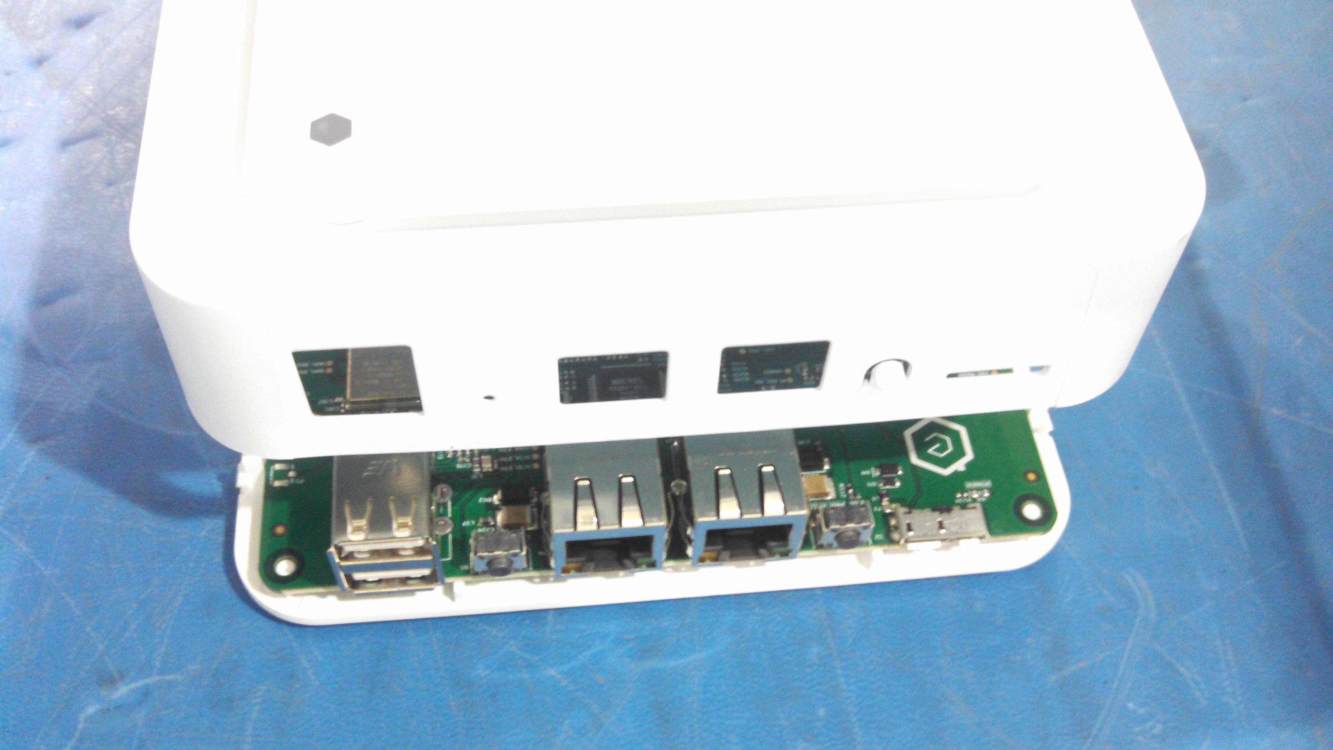
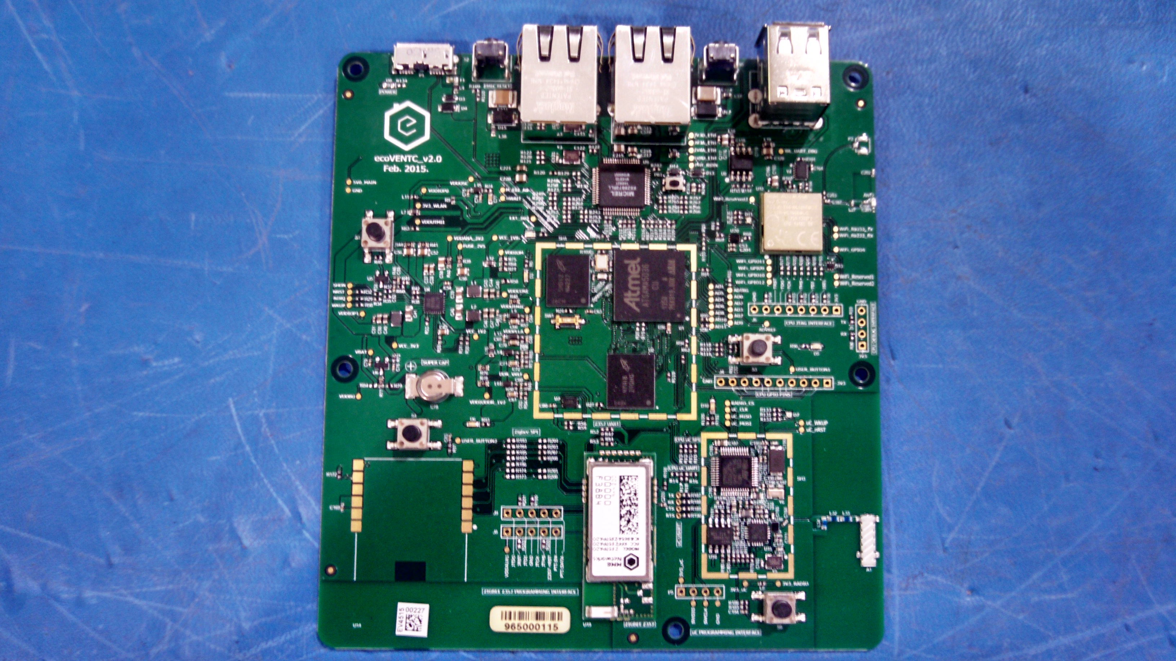
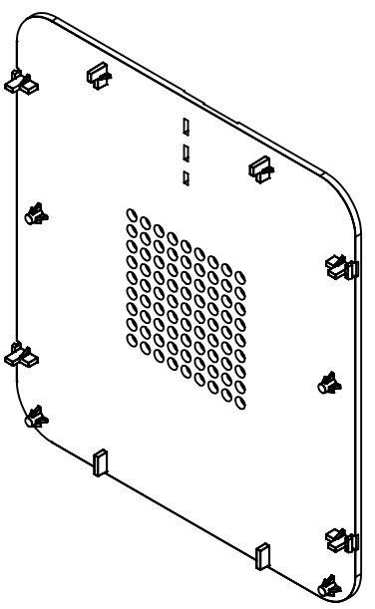
Align the Control Module PCA, PN 701-00011, onto the Control Hub Bottom Plate, PN 602-000331, using the alignment pins in the Control Hub Bottom Plate and the holes in the Control Module PCA. Install qty 4 m2.5x5 button head plastite screws PN 603-00020. Torque to 40 +/- 4 in oz.
Control Module PCA ( PN 701-00011 )
Control Hub Bottom Plate ( PN 602-000331 )
+
Note: Alignment Pins & Holes
(2 places shown, 4 places total)
Alignment Pins

Slide 2
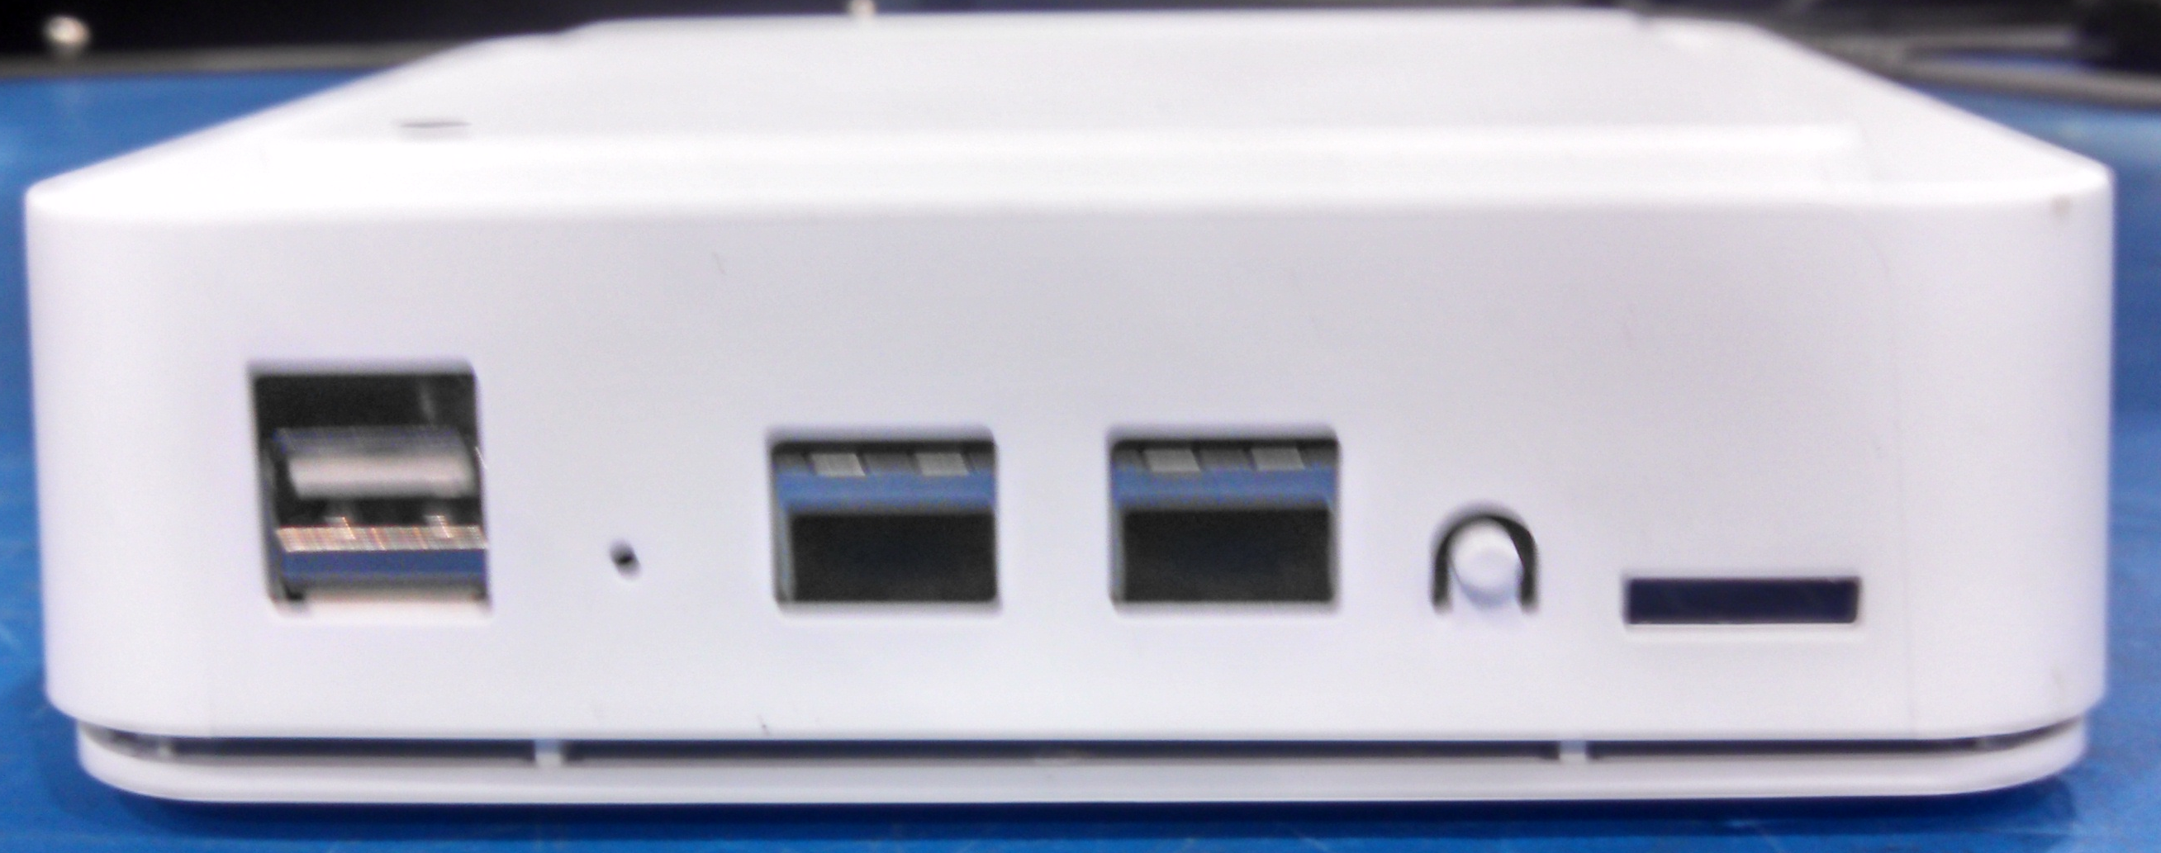
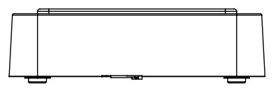
Install Control Hub Top Plate/Control Hub Main Housing Assembly onto the Control Hub Bottom Plate by aligning the connector cutouts with the connectors on the Control Hub Module. Gently press the cover until the two pieces snap into place. Proceed to FCT2 test
Gently press down cover to snap in place
Align connector cutouts with connectors on module

